Slide 1
Addressing Youth Isolation Fund
London Sport has set up the Addressing Youth Isolation Fund to identify how physical activity can be used to reduce isolation in young people (aged 14-19) especially during challenging periods of life. We want to see how physical activity can support young people who may be feeling isolated due to challenges like lockdown, school transitions, relocation, or separation from loved ones.
Background
London Sport exists to make London the most physically active city in the world. We are supported by Sport England and the Mayor of London, and work in partnership with London’s Local Authorities and a host of other organisations to support less active Londoners to build physical activity habits that support their health, wellbeing and prosperity. A key aspiration of London Sport is giving young people a physical activity habit for life. To help achieve this aspiration, we want to learn more about how organisations working to improve young people’s lives can use physical activity to achieve their aims. This year, we are looking to identify how physical activity can be used to reduce isolation in young people especially during challenging periods of life (challenges like lockdown, school transitions, relocation, or separation from loved ones).
Why Isolation
In 2018 the Office for National Statistics reported that 11.3% of children in the UK said that they were “often” lonely; this was more common among children living in a cities with 19.5% reporting “often” feeling lonely, compared with just over 5% of those living in either towns or rural areas. The same research found that 1 in 10 young people aged 16 to 24 said they were often lonely. Isolation affects people’s health, with individuals who report being lonely ‘often’ being twice as likely to rate their health as ‘poor’ or ‘fair’ than those who report being lonely ‘less than often’. There is also evidence that social isolation increases the risk of premature death as well as a number of serious health conditions. Research conducted on how covid-19 has affected isolation shows an increase in the number of young people who feel lonely with 52% of 18 to 24-year olds felt lonelier during lockdown. At London Sport we see every day how physical activity can bring people together, create communities and improve lives and we want to know how this can be used to tackle loneliness.
Source: ONS, Community Life Survey 2016-17
Aged 10-24
Source: The Health Foundation
Source: Campaign to End Loneliness
Source: POPULUS Coronavirus and health
Other resources used: Tortoise Media The Independent
Notes:
We want to identify
How can physical activity enhance services supporting young people during challenging periods of their life?
What role can physical activity have in preventing isolation in young people?
What role can physical activity have in tackling isolation in young people?
When using physical activity, what is required to reduce isolation in young people?
Key principles of the fund
This is a list of what we are looking to see from an application for this fund.
Helps answer 1 of the 4 questions above
Focused on 14-19 year olds
Most of those participating should be in this age bracket but we are comfortable with not all participants being in this age bracket.
COVID-19 safe
Interventions must follow the guidance at the time of writing. However, if you can display flexibility in planning this is helpful
‘Delivered’ for a minimum of 30 weeks
This means the intervention but does not mean the activity has to be the same for 30 weeks.
Interventions do not have to be a recognised sport, provided they get participants moving more.
Value for money
There is no set limit for what you can apply, however we will be scoring against the value for money of your bid to achieve the 5 aims above
You can apply for revenue or capital costs (again mindful of VFM) If you are not sure ask.

Slide 2
We want to identify
How can physical activity enhance services supporting young people during challenging periods of their life?
What role can physical activity have in preventing isolation in young people?
What role can physical activity have in tackling isolation in young people?
When using physical activity, what is required to reduce isolation in young people?
Key principles of the fund
This is a list of what we are looking to see from an application for this fund.
Helps answer 1 of the 4 questions above.
Focused on 14-19 year olds.
Most of those participating should be in this age bracket but we are comfortable with not all participants being in this age bracket.
3. Involves young people in the design.
4. COVID-19 safe.
Interventions must follow the guidance at the time of writing. However, if you can display flexibility in planning this is helpful
5. ‘Delivered’ for a minimum of 30 weeks.
This means the intervention but does not mean the activity has to be the same for 30 weeks.
Interventions do not have to be a recognised sport, provided they get participants moving more.
6. Offers value for money.
There is no set limit for what you can apply, however we will be scoring against the value for money of your bid to achieve the 5 aims above
You can apply for revenue or capital costs. If you are not sure ask.

Slide 3
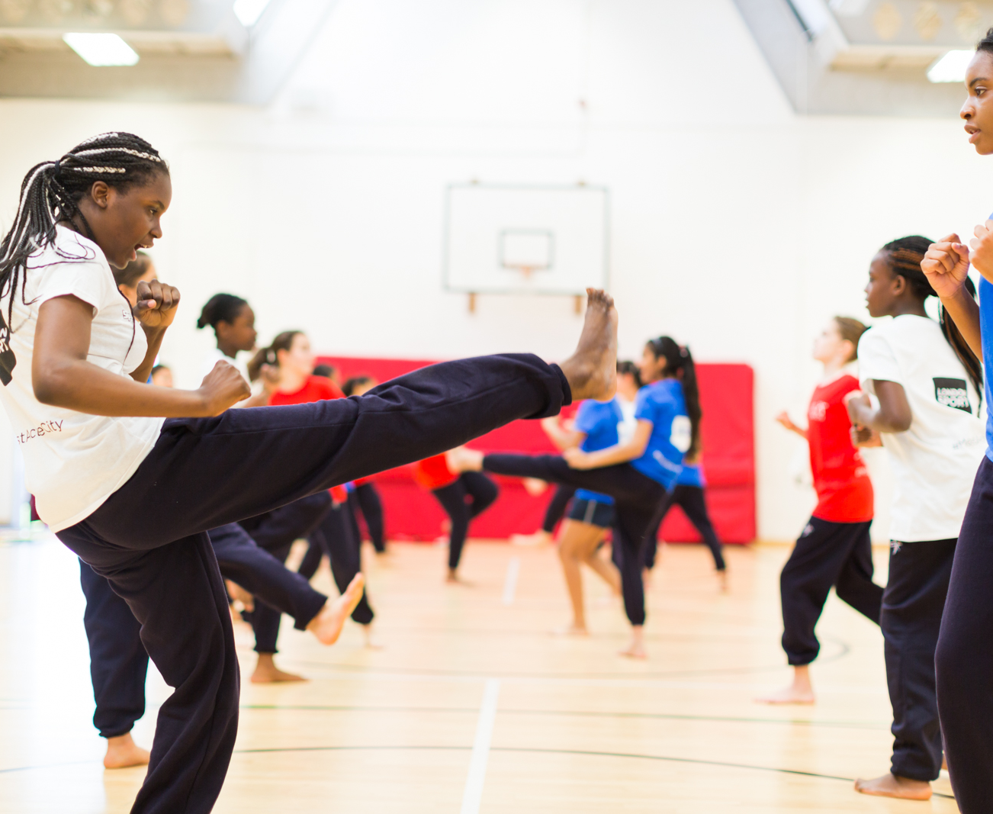
ADDRESSING YOUTH ISOLATION FUND
David Gentles

Slide 4
AGENDA
Please mute unless speaking & camera on/off optional
14.00 Presentation- The Addressing Youth Isolation Fund- DG
  What is the fund
  Useful dates
14.25 How is links to wider Bromley priorities
14.30 Comments & Questions From You

Slide 6
AIM
How can physical activity can be used to reduce isolation in young people?
4 Questions
How can physical activity enhance services supporting young people during challenging periods of their life?
What role can physical activity have in preventing isolation in young people?
What role can physical activity have in tackling isolation in young people?
When using physical activity, what is required to reduce isolation in young people?

Slide 7

WHY ISOLATION
1 in 10 young people often feel lonely
  Source: ONS, Community Life Survey 2016-17
Loneliness linked to a number of diseases
Source: The Health Foundation
How can physical activity be used to address this?

Slide 8
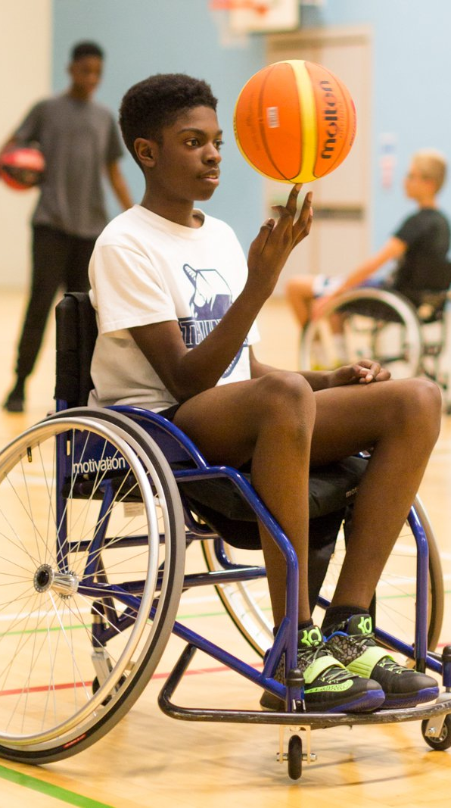
FUND PRINCIPLES
Helps answer 1 of the 4 questions
Focused on 14-19 year olds
Involves young people in design
COVID-19 safe
‘Delivered’ for a minimum of 30 weeks
Value for money

Slide 9
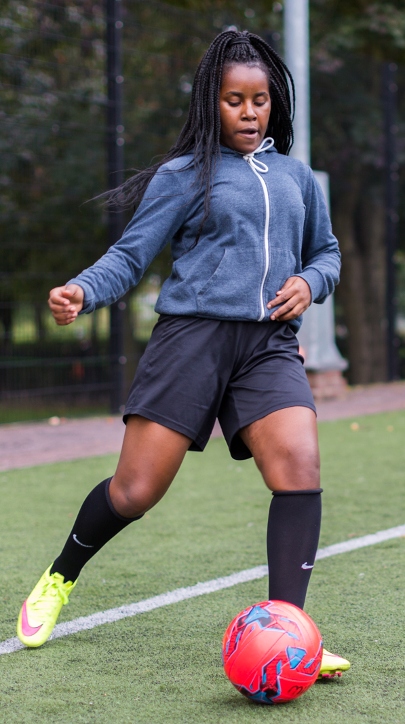
DATES
Date | Support
January 13th | Information session with prospective partners on Zoom (60 attended)
End Jan | Opportunity for prospective partners to talk through their ideas for the fund with London Sport staff/ strategic partners
Start Feb | Application window opens
End Feb | Application window closed
End March | Funding contract signed

Slide 10
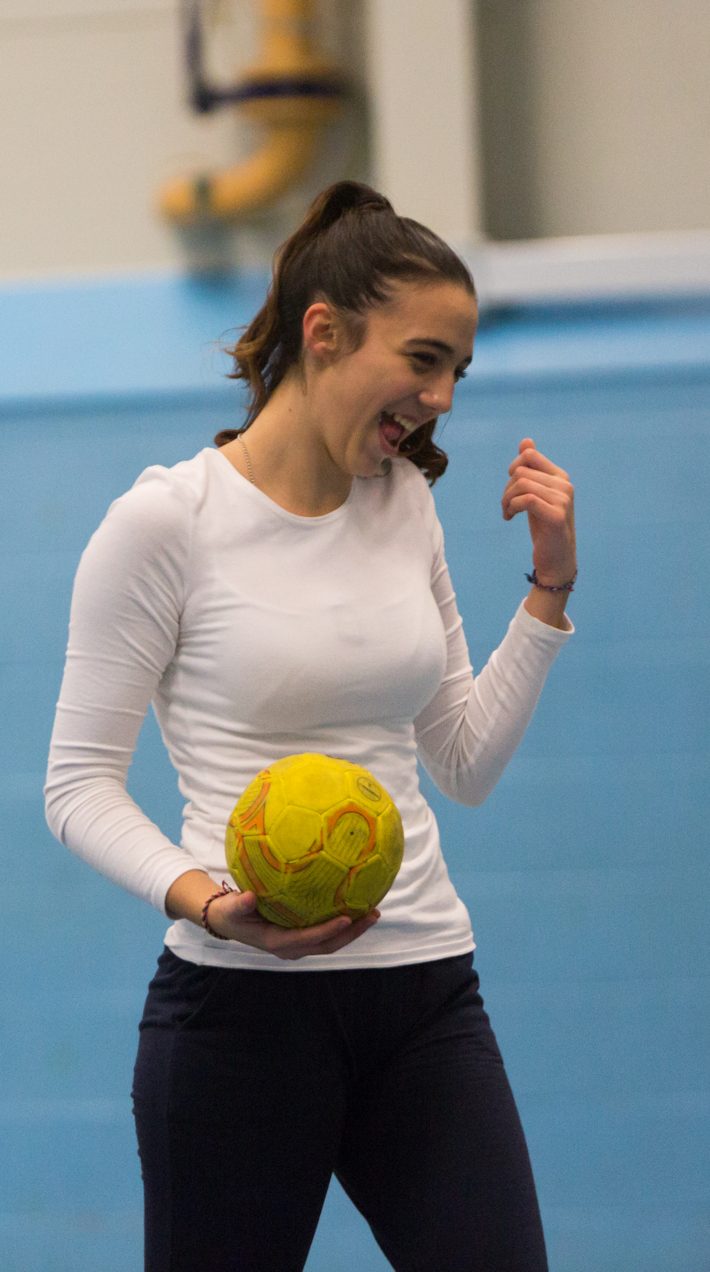
QUESTIONS
How does your service work with young people?
  BC (before COVID-19)
  DC (during COVID-19)
What monitoring & evaluation do you currently do on projects/ with young people?
Does your organisation do any physical activity with young people?

Slide 11
COMMENTS & QUESTIONS
How can physical activity can be used to reduce isolation in young people?
4 Questions
How can physical activity enhance services supporting young people during challenging periods of their life?
What role can physical activity have in preventing isolation in young people?
What role can physical activity have in tackling isolation in young people?
When using physical activity, what is required to reduce isolation in young people?

Slide 12
ADDRESSING YOUTH ISOLATION FUND
David.Gentles@londonsport.org
john.arthur@Londonsport.org
Notes:
Thanks,
-Send presentation and info by email later today
- Any questions get in touch

